Slide 1


MIAD
Maestría
en Inteligencia Analítica de Datos

Slide 2



Decisiones sobre la publicidad y las comunicaciones
Caso: OfficeStar
MIAD
Maestría
en Inteligencia Analítica de Datos
Sesión sincrónica
Ejercicio semana 6

Slide 3



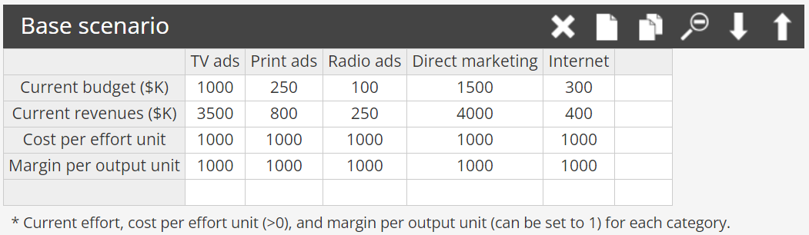
An office-supply company named OfficeStar tries to optimize the various channels used to advertise its stores.

Slide 4
Response function calibration
Parameters for TV ads
 | Ceiling | Floor | Slope | Intercept
Parameters | 4 900 | 4.830 | 1.781 | 87 959.825
Model fit for TV ads
 | Effort | Impact | Fit
None | 0.00 | 0 | 4.83
Low | 500.00 | 2 100 | 2 068.49
Base | 1 000.00 | 3 500 | 3 503.26
High | 1 500.00 | 4 200 | 4 104.91
Saturation | Saturation | 4 900 | 4 900.00

Slide 5
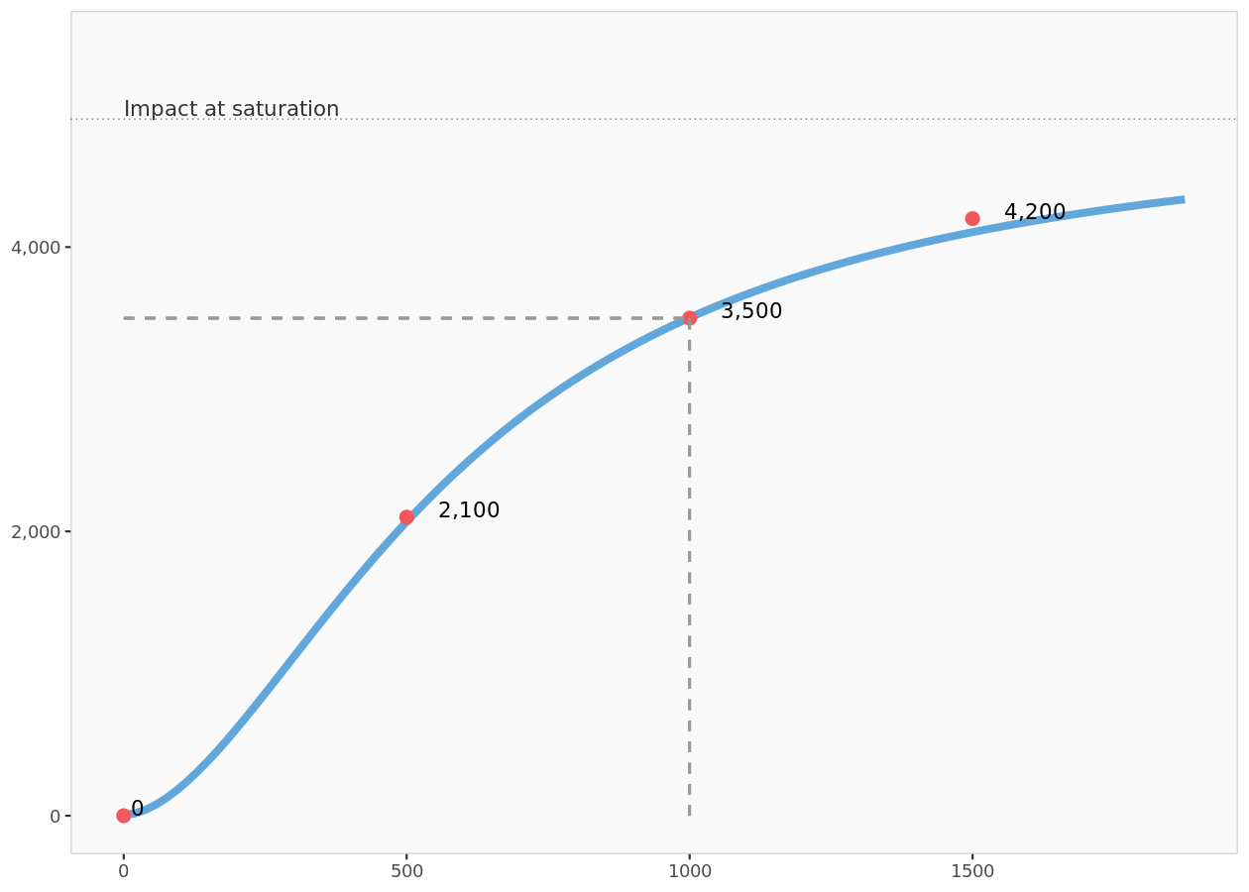
Model fit for TV ads

Slide 6
Parameters for Print ads
 | Ceiling | Floor | Slope | Intercept
Parameters | 1 600 | 0.000 | 0.012 | -2.968
Model fit for Print ads
 | Effort | Impact | Fit
None | 0.00 | 0 | 78.2
Low | 125.00 | 320 | 295.6
Base | 250.00 | 800 | 799.5
High | 375.00 | 1 280 | 1 303.9
Saturation | Saturation | 1 600 | 1 600.0

Slide 7
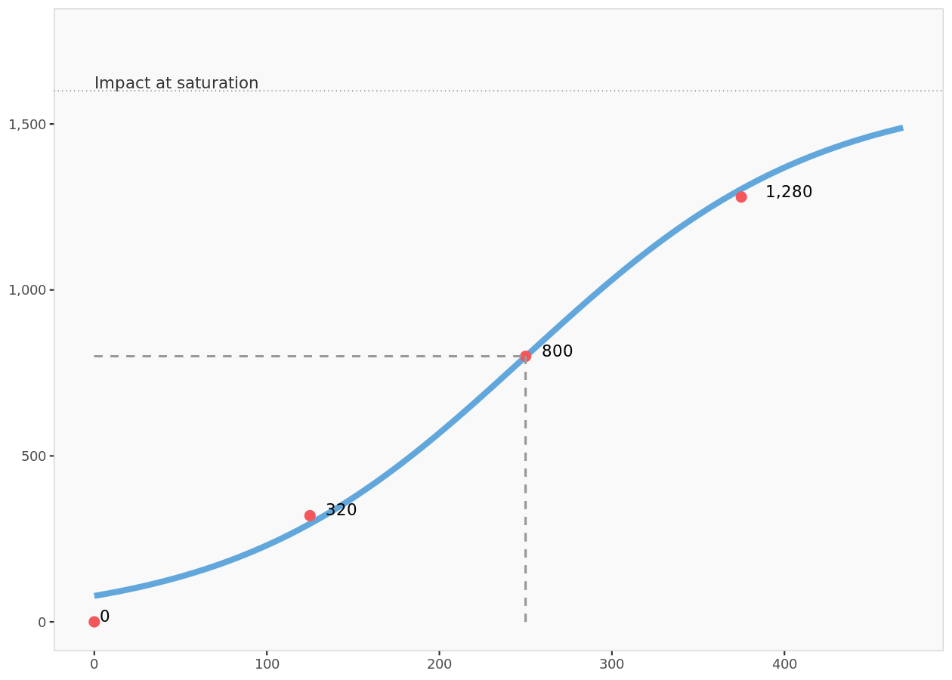
Model fit for Print ads

Slide 8
Parameters for Radio ads
 | Ceiling | Floor | Slope | Intercept
Parameters | 350 | 0.000 | 3.797 | 15 756 945.311
Model fit for Radio ads
 | Effort | Impact | Fit
None | 0.00 | 0.0 | 0.0
Low | 50.00 | 50.0 | 53.2
Base | 100.00 | 250.0 | 249.8
High | 150.00 | 312.5 | 322.3
Saturation | Saturation | 350.0 | 350.0

Slide 9
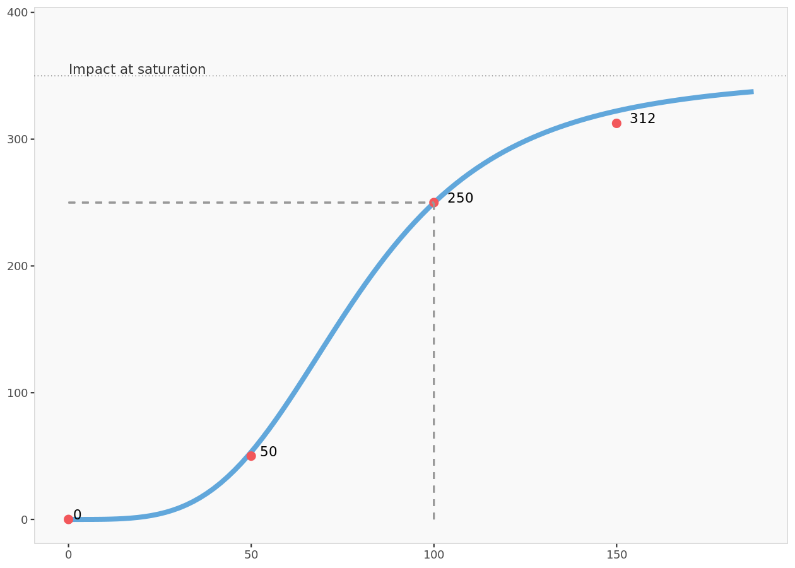
Model fit for Radio ads

Slide 10
Parameters for Direct marketing
 | Ceiling | Floor | Slope | Intercept
Parameters | 11 200 | 213.744 | 0.002 | -3.845
Model fit for Direct marketing
 | Effort | Impact | Fit
None | 0.00 | 0 | 444
Low | 750.00 | 2 000 | 1 270
Base | 1 500.00 | 4 000 | 4 014
High | 2 250.00 | 8 400 | 8 173
Saturation | Saturation | 11 200 | 11 200

Slide 11
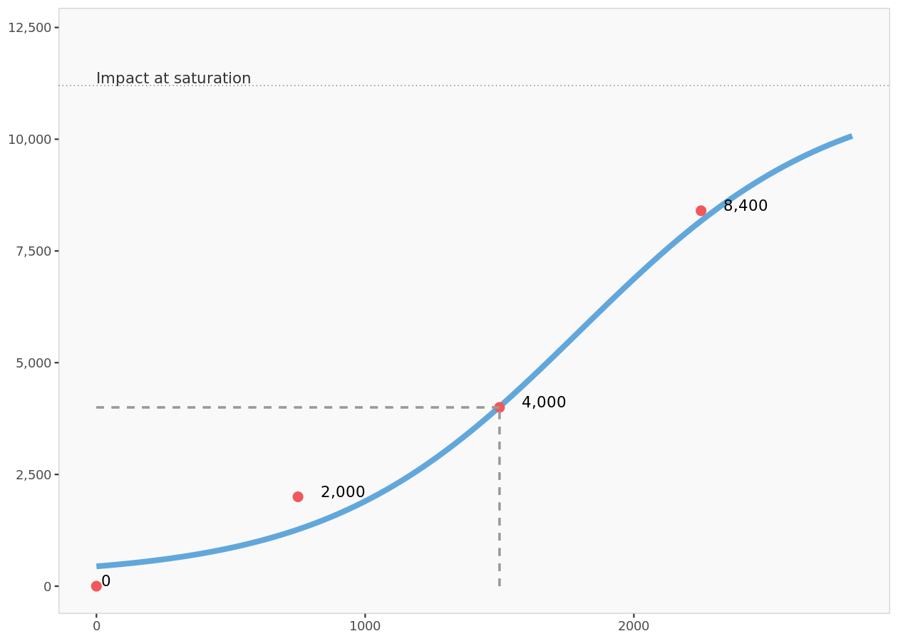
Model fit for Direct marketing

Slide 12
Parameters for Internet
 | Ceiling | Floor | Slope | Intercept
Parameters | 840 | 0.000 | 0.013 | -4.133
Model fit for Internet
 | Effort | Impact | Fit
None | 0.00 | 0.0 | 13.3
Low | 150.00 | 80.0 | 90.4
Base | 300.00 | 400.0 | 399.7
High | 450.00 | 720.0 | 732.7
Saturation | Saturation | 840.0 | 840.0

Slide 13
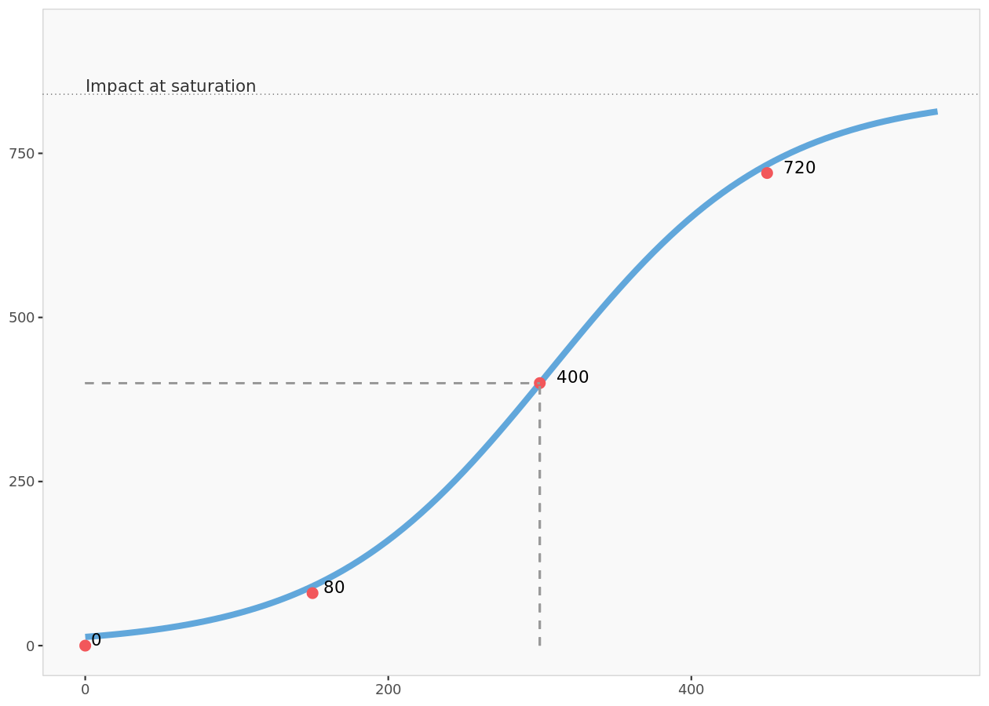
Model fit for Internet

Slide 14
Base scenario table
 | Current budget ($K) | Current revenues ($K) | Cost per effort unit | Margin per output unit | Cost of effort | Gross margin | Net margin
TV ads | 1 000.00 | 3 500 | 1 000.00 | 1 000.00 | 1 000 000 | 3 500 000 | 2 500 000
Print ads | 250.00 | 800 | 1 000.00 | 1 000.00 | 250 000 | 800 000 | 550 000
Radio ads | 100.00 | 250 | 1 000.00 | 1 000.00 | 100 000 | 250 000 | 150 000
Direct marketing | 1 500.00 | 4 000 | 1 000.00 | 1 000.00 | 1 500 000 | 4 000 000 | 2 500 000
Internet | 300.00 | 400 | 1 000.00 | 1 000.00 | 300 000 | 400 000 | 100 000
Total | 3 150.00 | 8 950 |  |  | 3 150 000 | 8 950 000 | 5 800 000
Comparison of effort in unconstrained optimization
 | Base effort | Optimized effort | % change in effort
TV ads | 1 000 | 1 345 | 34.5%
Print ads | 250 | 488 | 95.4%
Radio ads | 100 | 135 | 34.7%
Direct marketing | 1 500 | 3 231 | 115.4%
Internet | 300 | 472 | 57.4%
Total | 3 150 | 5 672 | 80.1%

Slide 15
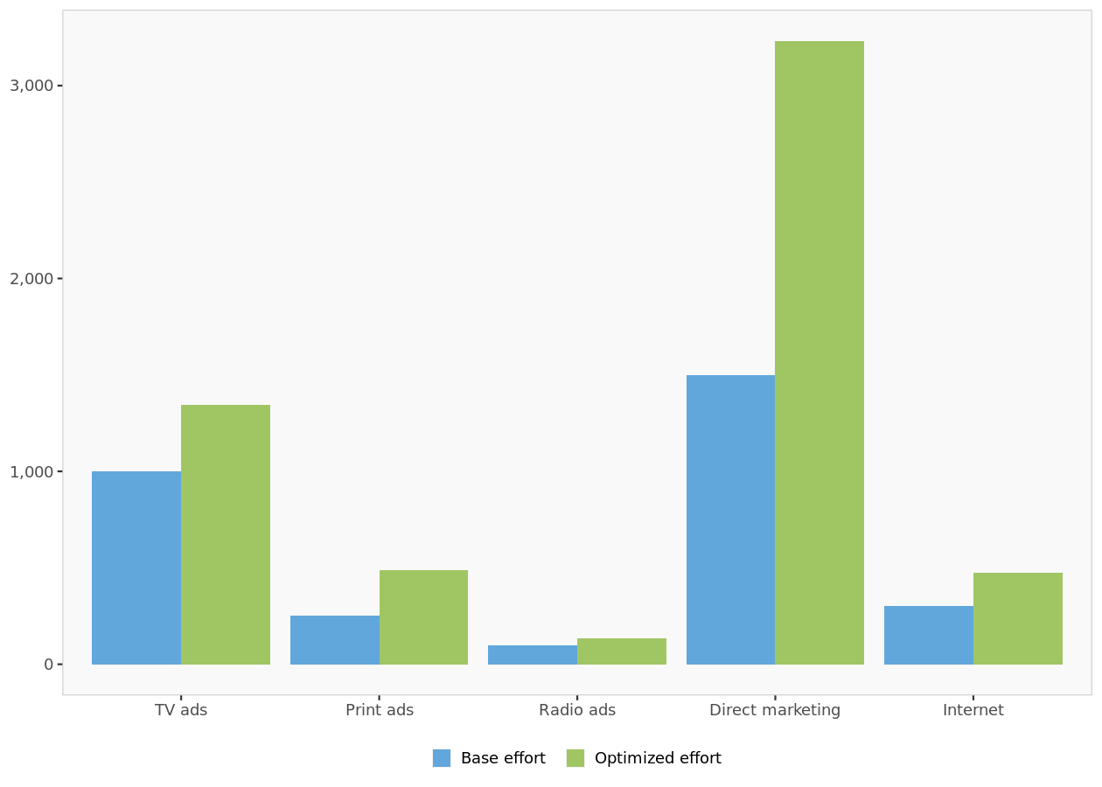
Comparison of effort in unconstrained optimization

Slide 16
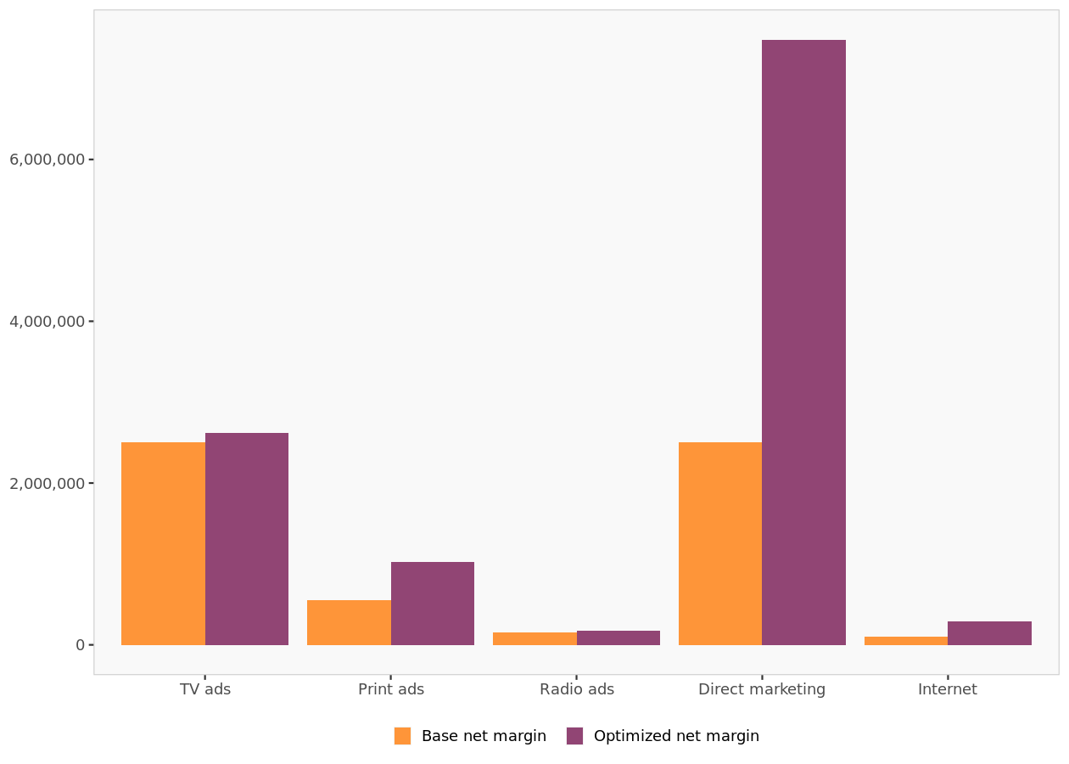
Comparison of net margin in unconstrained optimization
 | Base net margin | Optimized net margin | % change in margin
TV ads | 2 500 000 | 2 621 935 | 4.9%
Print ads | 550 000 | 1 022 282 | 85.9%
Radio ads | 150 000 | 175 201 | 16.8%
Direct marketing | 2 500 000 | 7 479 220 | 199.2%
Internet | 100 000 | 285 510 | 185.5%
Total | 5 800 000 | 11 584 149 | 99.7%

Slide 17
Effort level | Net margin
4.000 | 10.515.345
4.400 | 10.771.102
4.600 | 11.034.645
4.800 | 11.238.770
5.000 | 11.391.104
5.200 | 11.493.716
5.400 | 11.556.223
5.600 | 11.582.396
5.672 | 11.584.149

Slide 18
Table of constraints
 | Global constraints | TV ads | Print ads | Radio ads | Direct marketing | Internet
Minimum | 0 | 750 | 0 | 0 | 0 | 0
Maximum | 4000 | NA | NA | NA | NA | 500
Comparison of effort in constrained optimization
 | Base effort | Optimized effort | % change in effort
TV ads | 1 000 | 842.712 | -15.7%
Print ads | 250 | 399.431 | 59.8%
Radio ads | 100 | 0.001 | -100.0%
Direct marketing | 1 500 | 2 760.648 | 84.0%
Internet | 300 | 0.001 | -100.0%
Total | 3 150 | 4 002.793 | 27.1%

Slide 19
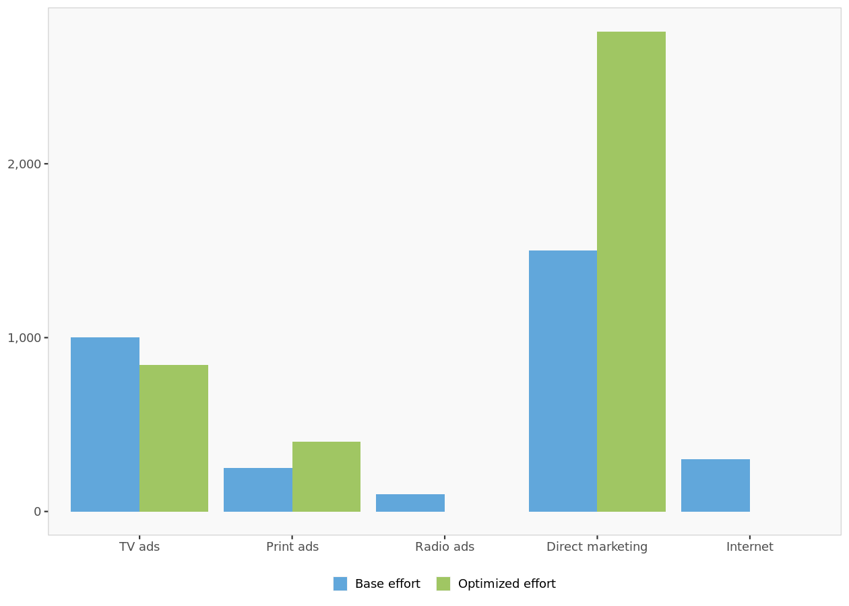
Comparison of effort in constrained optimization

Slide 20
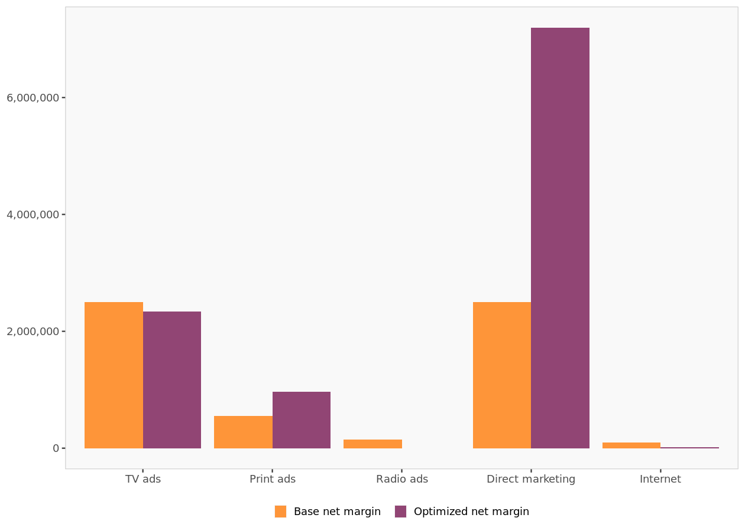
Comparison of net margin in constrained optimization
 | Base net margin | Optimized net margin | % change in margin
TV ads | 2 500 000 | 2 337 680.275 | -6.5%
Print ads | 550 000 | 968 150.424 | 76.0%
Radio ads | 150 000 | -1.000 | -100.0%
Direct marketing | 2 500 000 | 7 196 265.976 | 187.9%
Internet | 100 000 | 13 249.576 | -86.8%
Total | 5 800 000 | 10 515 345.252 | 81.3%

Slide 21
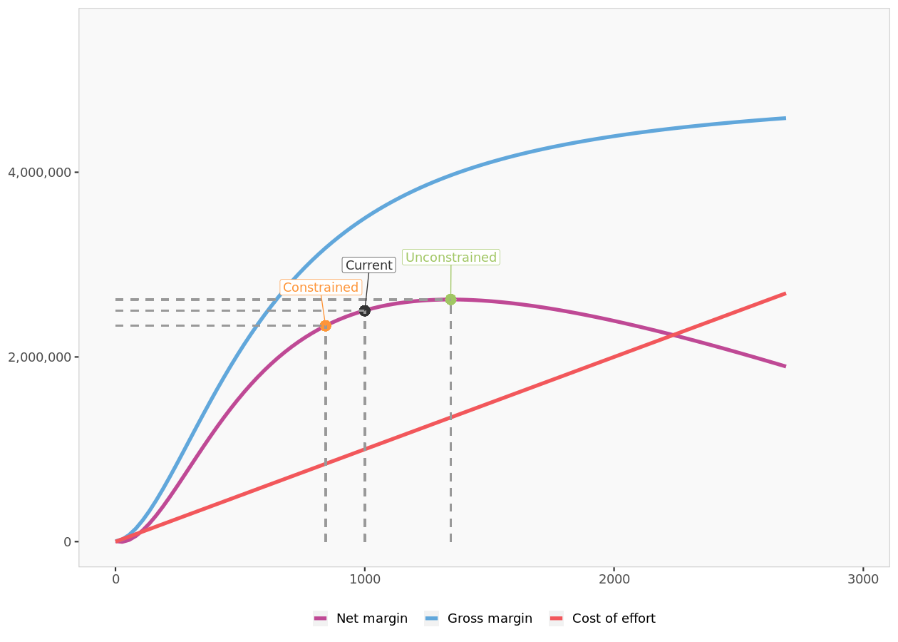
TV ads: scenarios

Slide 22
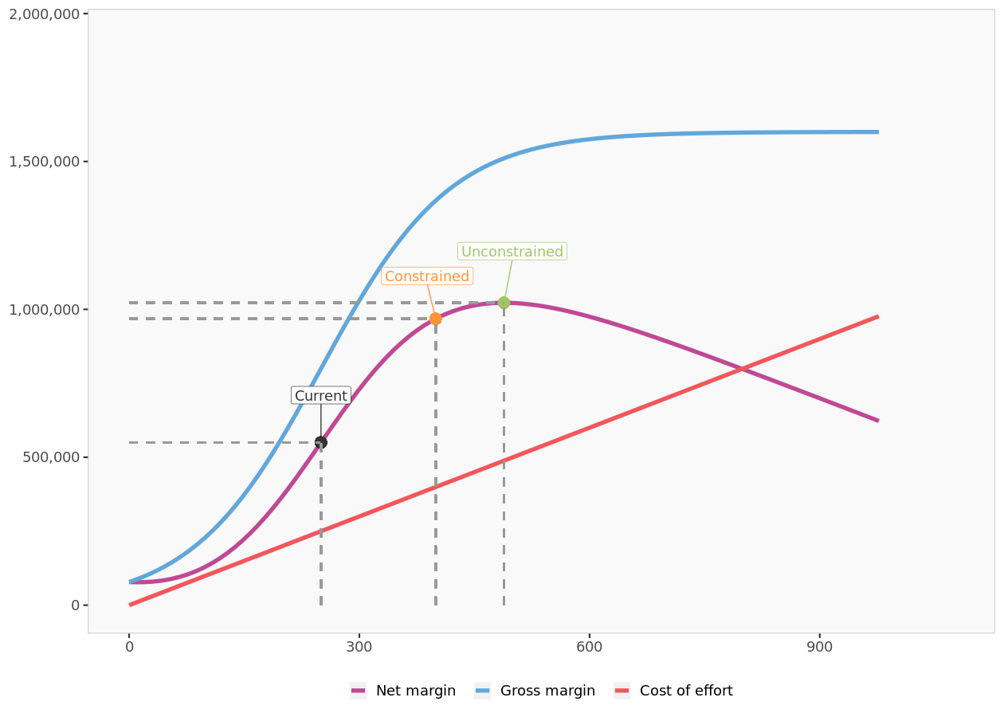
Print ads: scenarios

Slide 23
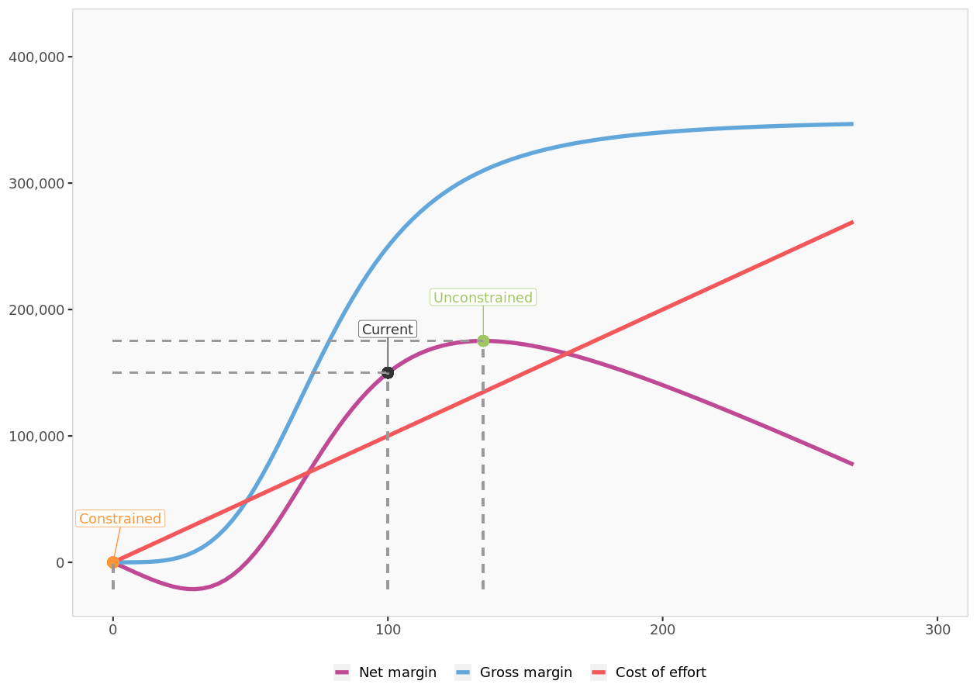
Radio ads: scenarios

Slide 24
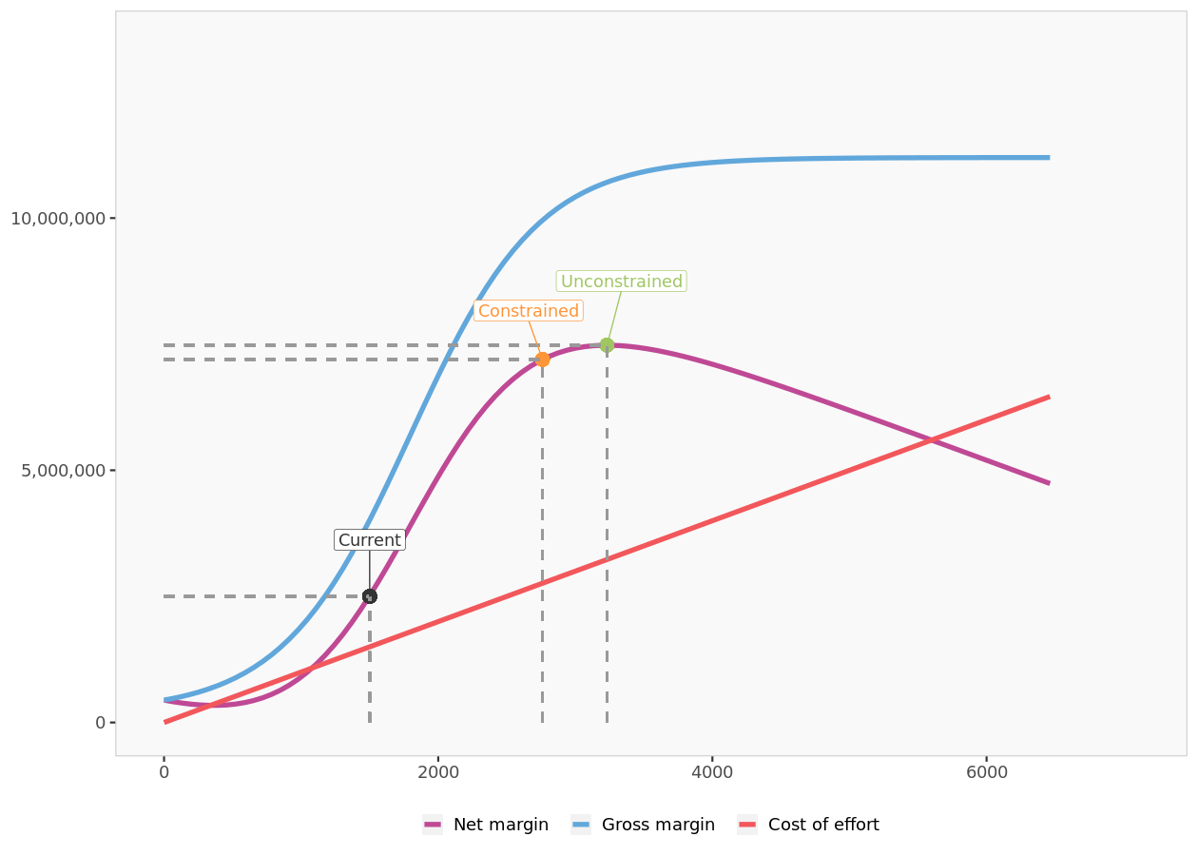
Direct marketing: scenarios

Slide 25
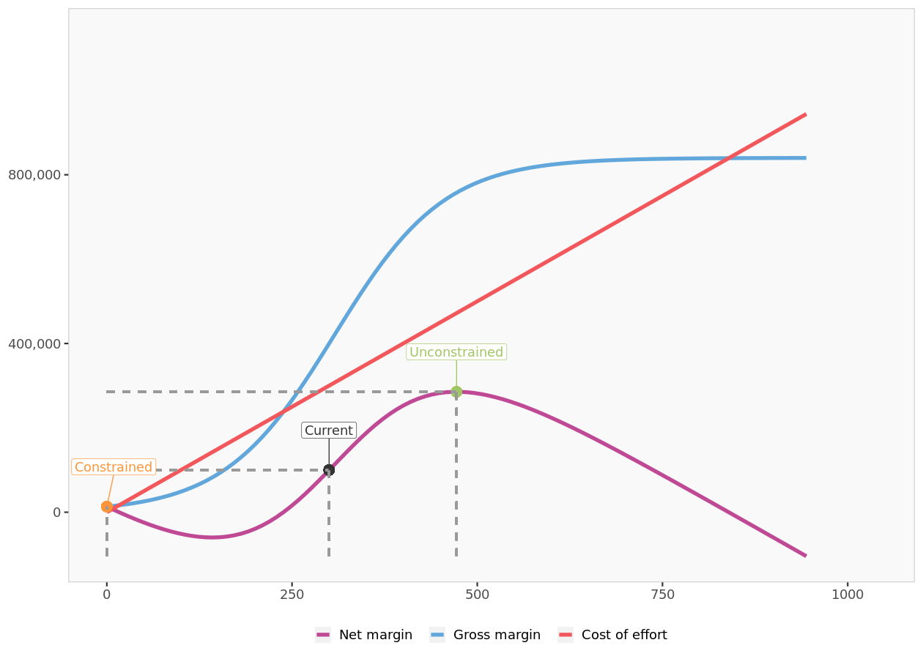
Internet: scenarios

Slide 26
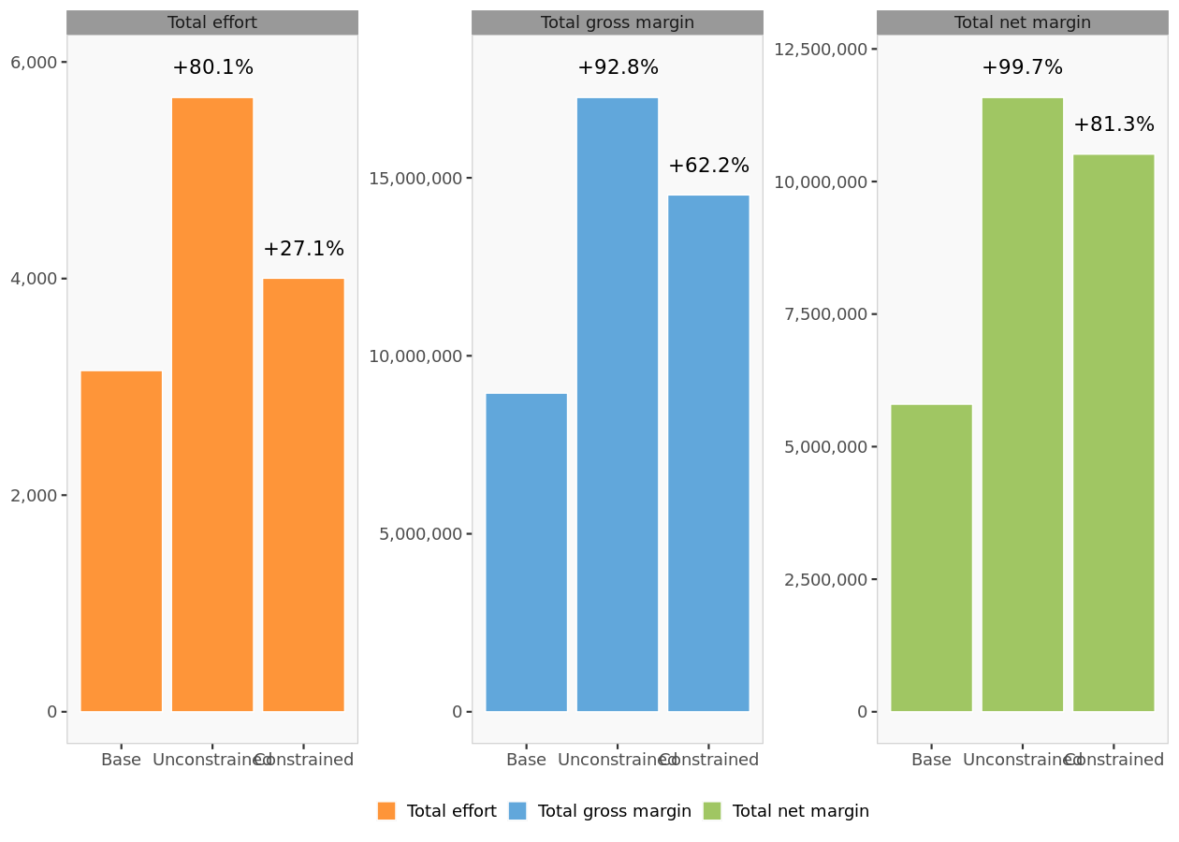
Comparison of scenarios

Slide 27


Marketing
Analytics
MIAD
Maestría
en Inteligencia Analítica de Datos

